Slide 1
ISO31000:2018 – RISK MANAGEMENT – 8 PRINCIPLES
A Risk Practitioners Guide To ISO31000:2018
https://www.theirm.org/media/3513119/IRM-Report-ISO-31000-2018-v3.pdf

Slide 2
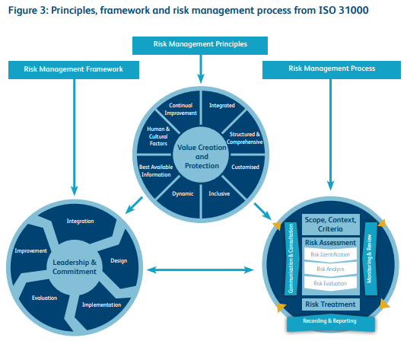
ISO31000:2018 – RISK MANAGEMENT – AN INTRO

Slide 3
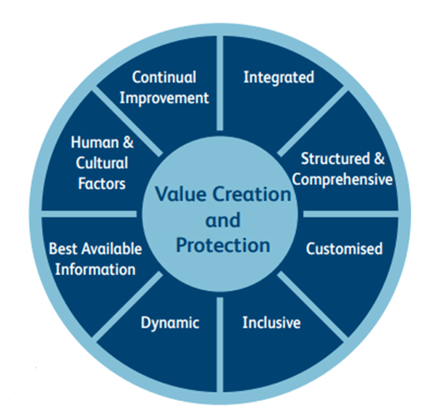
ISO31000:2018 – RISK MANAGEMENT – AN INTRO
8 PRINCIPLES

Slide 4
ISO31000:2018 – RISK MANAGEMENT – 8 PRINCIPLES
PRINCIPLES:
Framework and processes should be customized and proportionate.
Appropriate and timely involvement of stakeholders is necessary.
Structured and comprehensive approach is required.

Slide 5
ISO31000:2018 – RISK MANAGEMENT – 8 PRINCIPLES
PRINCIPLES:
4. Risk management is an integral part of all organizational activities.
5. Risk management anticipates, detects, acknowledges and responds to changes.
6. Risk management explicitly considers any limitations of available information.

Slide 6
ISO31000:2018 – RISK MANAGEMENT – 8 PRINCIPLES
PRINCIPLES:
7. Human and cultural factors influence all aspects of risk management.
8. Risk management is continually improved through learning and experience.

Slide 7
ISO31000:2018 – RISK MANAGEMENT – 8 PRINCIPLES
The first five principles provide guidance on how a risk management initiative should be designed, and principles six, seven and eight relate to the operation of the risk management initiative.

Slide 8
ISO31000:2018 – RISK MANAGEMENT – 8 PRINCIPLES
The latter principles confirm that the best information available should be used; human and cultural factors should be considered; and the risk management arrangements should ensure continual improvement.

Slide 9
ISO31000:2018 – RISK MANAGEMENT – 8 PRINCIPLES
The first five principles are concerned with the design and planning of the risk management initiative and these principles are often summarized as proportionate, aligned, comprehensive, embedded and dynamic (PACED), as shown in Table 1.

Slide 10
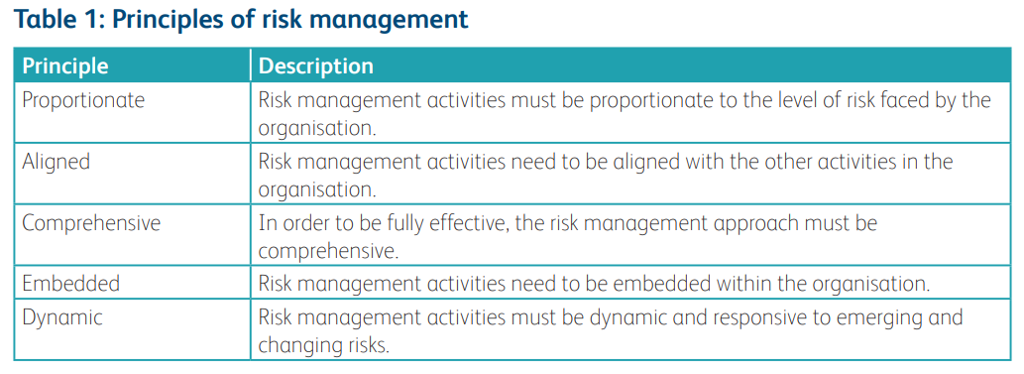
ISO31000:2018 – RISK MANAGEMENT – AN INTRO

Slide 11
ISO31000:2018 – RISK MANAGEMENT – 8 PRINCIPLES
A Risk Practitioners Guide To ISO31000:2018
https://www.theirm.org/media/3513119/IRM-Report-ISO-31000-2018-v3.pdf
END

